Slide 1
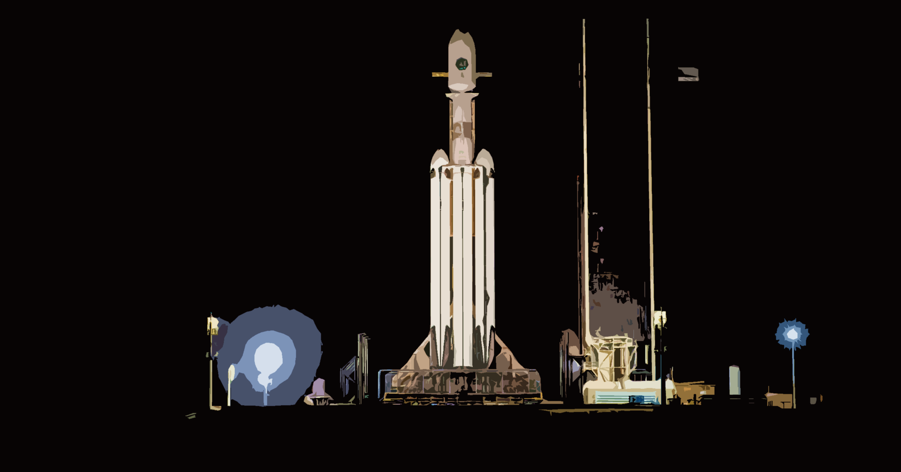

Winning Space Race with Data Science
05.03.2023
by Gökhan Dede
https://github.com/Gokhan-Dede

Slide 2
Outline
Executive Summary
Introduction
Methodology
Results
Conclusion
Appendix

Slide 3


Executive Summary
Summary of techniques
Collection of data via API and web scraping
Exploratory Data Analysis (EDA) with Visualization of Data
EDA with SQL
Interactive Map using Folium
Dashboard utilizing Plotly Dash
Predictive Analysis
A summary of all results
Outcomes of exploratory data analysis
Dashboard with Interactive Maps
Predictive Results

Slide 4
Introduction
As a revolutionary company, SpaceX has shaken up the space market by delivering rocket launches, in particular Falcon 9, for as little as $62 million, while rival companies charge as much as $165 million. Most of these cost savings have come from SpaceX's brilliant plan to land rockets again after each launch and use them for other missions. If you keep doing this, you can get the price even lower.
«For this project, my role as a data scientist for a startup that aims to compete with SpaceX is to develop a machine learning pipeline that can predict the success of a prospective first-stage landing. With the results of this experiment, competitors can determine their launch bids against SpaceX.»
The problems included: • determining all of the variables that could affect the success of the landing; • how each independent variable correlates to the outcome; • the optimal conditions for optimizing the likelihood of a successful landing.

Slide 5

Section 1
Methodology

Slide 6
Methodology
Executive Summary
Data collection methodology:
Two different data sources were used to construct Space X dataframes:
SpaceX API: https://api.spacexdata.com/v4/
Webscraping from the internet (https://en.wikipedia.org/wiki/List_of_Falcon/_9/_and_Falcon_Heavy_launches)
Perform data wrangling
After collecting and analyzing the characteristics of the collected data, a landing outcome label was derived to further enrich the dataset.
Perform exploratory data analysis (EDA) using visualization and SQL
Perform interactive visual analytics using Folium and Plotly Dash
Perform predictive analysis using classification models
Data acquired up until this point was normalized, separated into training and test data sets, and evaluated by four different classification models, with the accuracy of each model assessed utilizing various variable combinations.

Slide 7
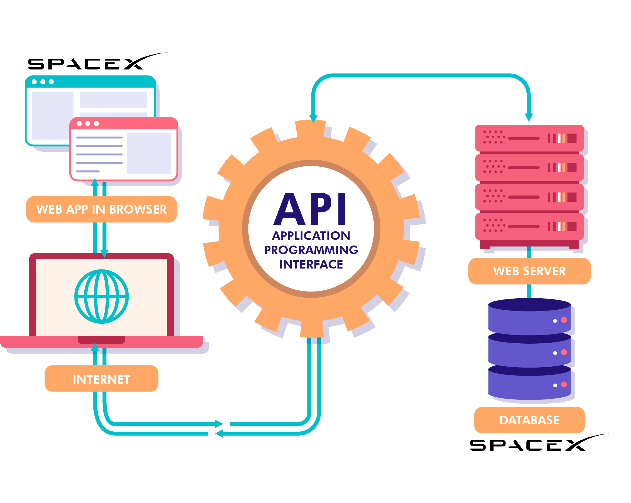

https://api.spacexdata.com/v4/launches/past
Data Collection
Firstly, the datasets were compiled by using the SpaceX REST API, so that we were able to interact with launch data from SpaceX.
• The API will give us information about launches, such as the type of rocket used, the payload that was sent, the parameters of the launch, the parameters of the landing, and the outcome of the landing.
• We intend to employ this data to determine the likelihood that a SpaceX rocket will land successfully.
• To access the SpaceX REST API, enter https://api.spacexdata.com/v4/ into your browser's address bar.
Secondly, webscraping Wikipedia with BeautifulSoup is another method used for obtaining Falcon 9 launch data.

Slide 8
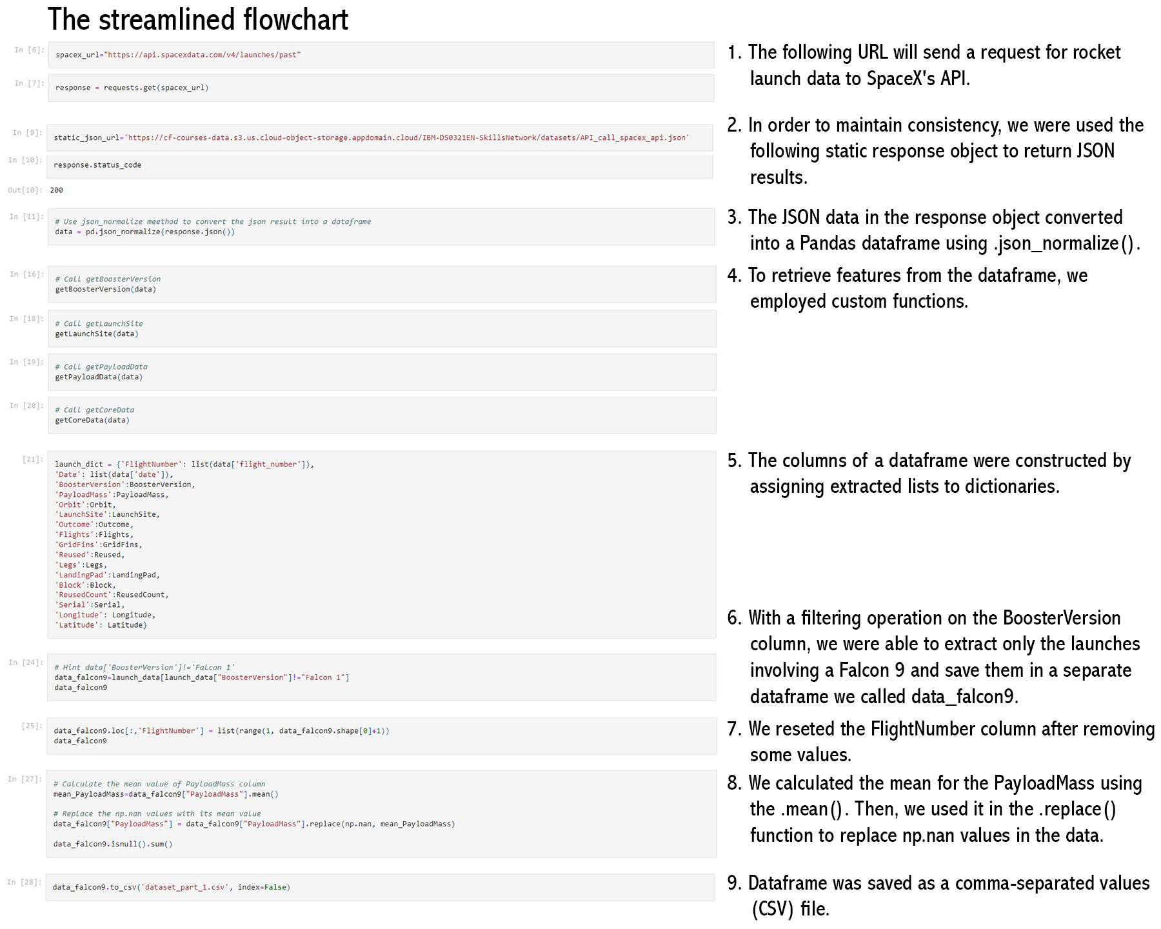
Data Collection SpaceX API
GitHub URL to Notebook
Request API and parse
the SpaceX launch data
Filter data to only include
Falcon 9 launches
Deal with Missing Values

Slide 9
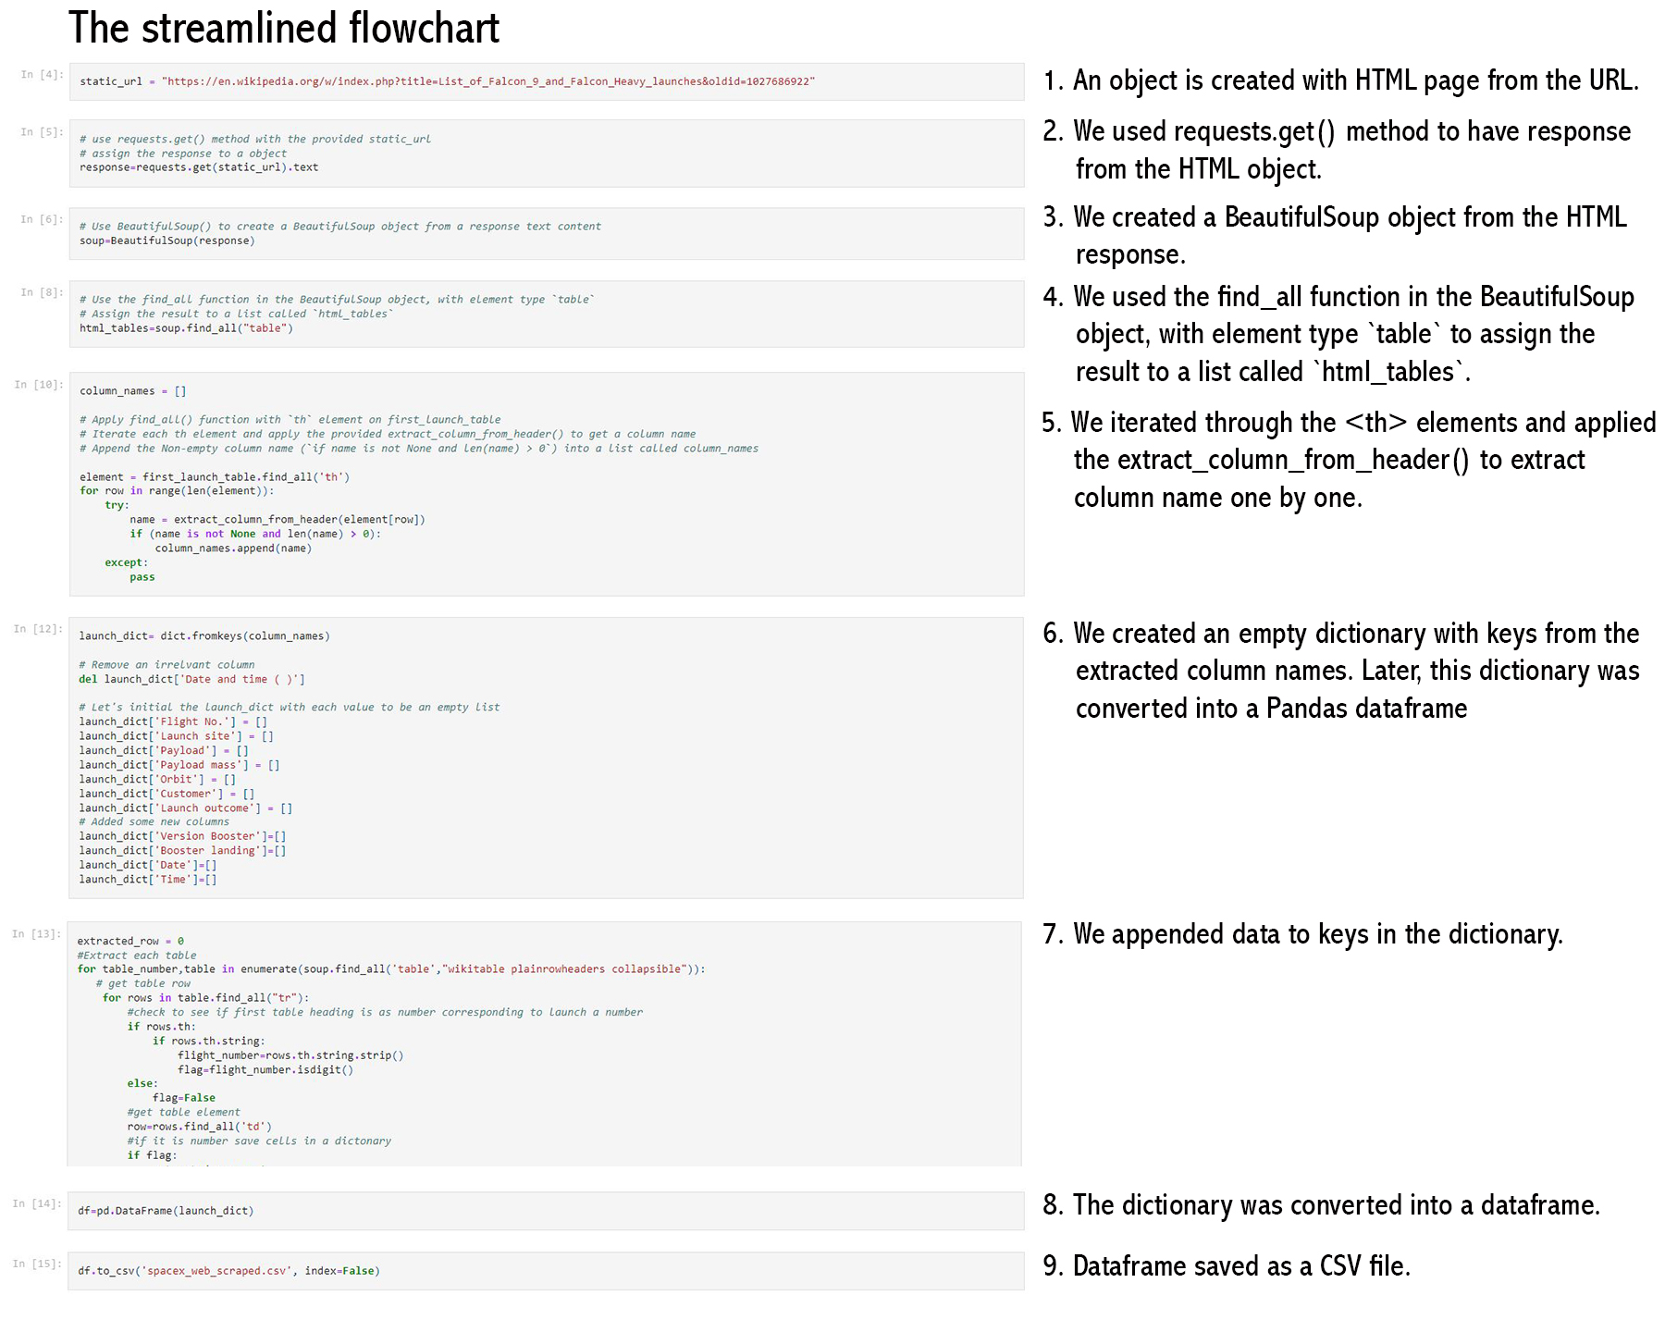
Data Collection
Scraping
GitHub URL to Notebook
Extract data
using BeautifulSoup
Get HTML Response
From Wikipedia
Create a data frame by
parsing the HTML tables
Normalize data into flat data file such as .csv

Slide 10
Data Wrangling
GitHub URL to Notebook
We performed some Exploratory Data Analysis (EDA) to find some patterns in the data and determine what would be the label for training supervised models.
Perform EDA on dataset
Calculate the number of launches at each site
Calculate the number and occurrence of each orbit
Create a landing outcome label from
Outcome column
Work out success rate for every landing in dataset
Calculate the number and occurrence of mission outcome per orbit type
Export dataset as .CSV
In the data set, there are several different cases where the booster did not land successfully. Sometimes a landing was attempted but failed due to an accident; for example,
True Ocean means the mission outcome was successfully landed to a specific region of the ocean while False Ocean means the mission outcome was unsuccessfully landed to a specific region of the ocean.
True RTLS means the mission outcome was successfully landed to a ground pad False RTLS means the mission outcome was unsuccessfully landed to a ground pad.
True ASDS means the mission outcome was successfully landed on a drone ship False ASDS means the mission outcome was unsuccessfully landed on a drone ship.
In this lab we will mainly convert those outcomes into Training Labels with 1 means the booster successfully landed 0 means it was unsuccessful.

Slide 11
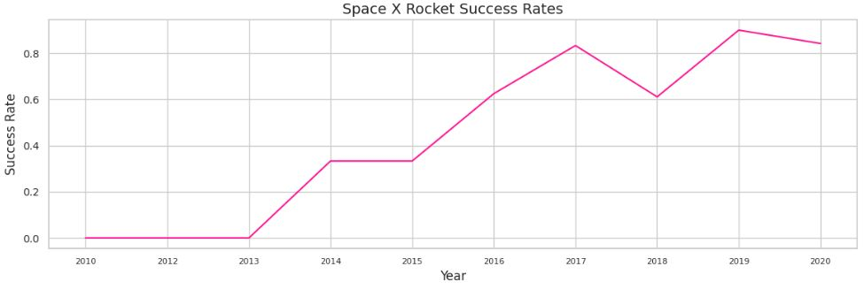
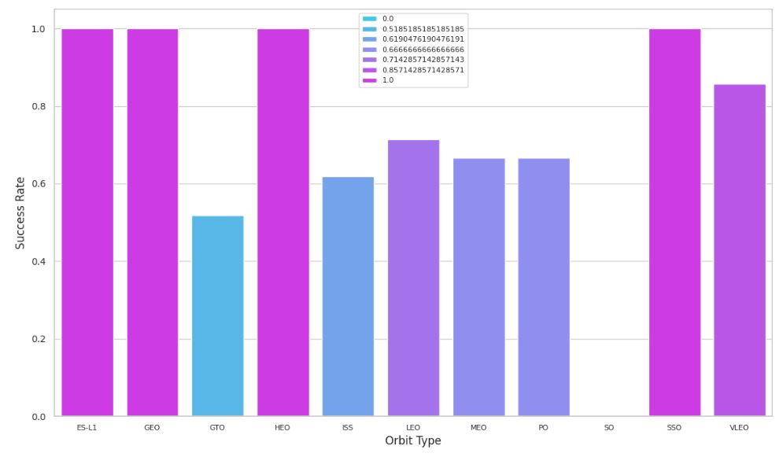
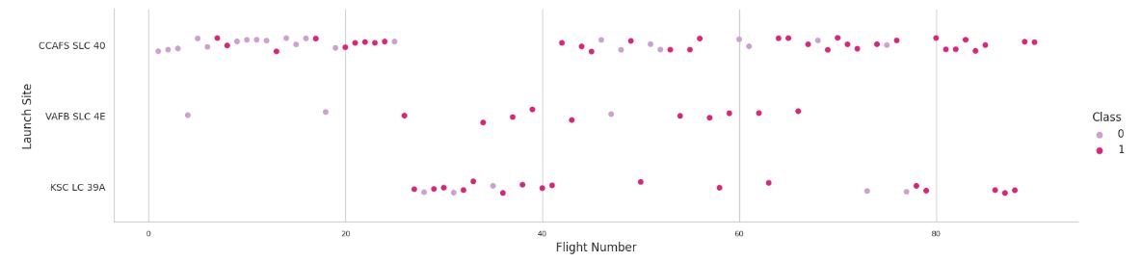
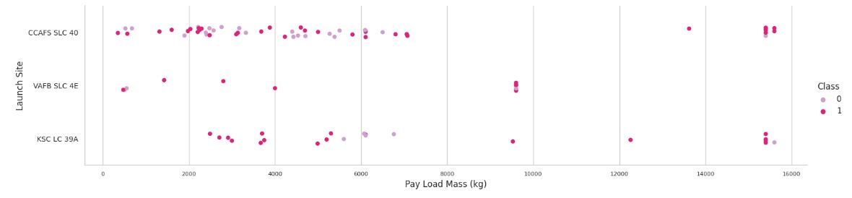
EDA with Data Visualization
GitHub URL to Notebook
Line Graph being drawn:
Success Rate VS. Year
Line graphs are helpful because they clearly display variables and trends, and they may be used to extrapolate future data.
Bar Graph being drawn:
Mean VS. Orbit
A bar diagram makes it easy to compare data across groupings. On one axis, the graph shows categories and on the other, discrete values. Showing the two axes' relationship is the purpose. Bar charts can display large data changes over time.
Scatter Graphs being drawn:
Flight Number VS. Payload Mass
Flight Number VS. Launch Site
Payload VS. Launch Site
Orbit VS. Flight Number
Payload VS. Orbit Type
Orbit VS. Payload Mass
Scatter plots reveal the extent to which one variable influences another. The connection between two metrics is known as a correlation. Data sets are typically quite large in scatter plots.

Slide 12

EDA with SQL
GitHub URL to Notebook
We executed SQL queries to extract details from the dataset. The following tasks are asked concerning the data to obtain the results from the dataset.
Display the names of the unique launch sites in the space mission;
Display 5 records where launch sites begin with the string "CCA";
Display the total payload mass carried by boosters launched by NASA;
Display average payload mass carried by booster version F9 v1.1;
List the date when the first succesful landing outcome in ground pad was acheived;
List the names of the boosters that have had success in drone ships and have a payload mass greater than 4000 but less than 6000;
List the total number of successful and failed mission outcomes;
List the names of the booster_versions which have carried the maximum payload mass;
List the records that will display the month names, failure landing_outcomes in drone ships, ,booster versions, launch_site for the months in 2015;
Rank the count of successful landing_outcomes between the date
04-06-2010 and 20-03-2017 in descending order.

Slide 13

Build an Interactive Map with Folium
GitHub URL to Notebook
The goal is to create an interactive map based on the launch data. We marked each launch site on the map by placing a marker in the shape of a circle at its latitude and longitude coordinates and labeling it with the location's name.
The launch_sites(failure, success) dataframe was then classified as class 0 and class 1, with red and green markers on the map, using MarkerCluster().
Then, we utilized Haversine's formula to figure out how far away the launch sites were from a variety of landmarks, such as:
How close are the launch sites to railways, highways, and coastlines?
How close are the launch sites to nearby cities?

Slide 14

Build a Dashboard with Plotly Dash
GitHub URL to Python File
With Plotly dash, we created an interactive dashboard that lets the user explore the data in whatever way they like.
A pie chart is a graphical representation of data that shows the percentage breakdown of different categories. Pie Chart in our dashboard is showing the total launches by a certain site/all sites, and display relative proportions of multiple classes of data.
A scatter graph demonstrates the correlation between two independent factors, and it is the greatest way to demonstrate a nonlinear pattern.Result vs Payload Mass (Kg) relationship exhibited using a Scatter Graph for different Booster Versions.

Slide 15
Predictive Analysis (Classification)
GitHub URL to Notebook
Four classification methods — logistic regression, support vector machine, decision tree, and k nearest neighbors — were compared.
1. Import the data into NumPy and Pandas. 2. Transform the data before separating it into training and test datasets. 3. Choose the type of machine learning to employ. 4. Configure GridSearchCV's parameters and algorithms and fit them to the dataset.
1. Check the accuracy for each model
2. Get tuned hyperparameters for each type of algorithms.
3. Plot the confusion matrix.
1. Use Feature Engineering and Algorithm Tuning
1. The model with the best accuracy score will be the best performing model.
Find the Best Model
Improving the Model
Evaluating the Model
Building the Model

Slide 16
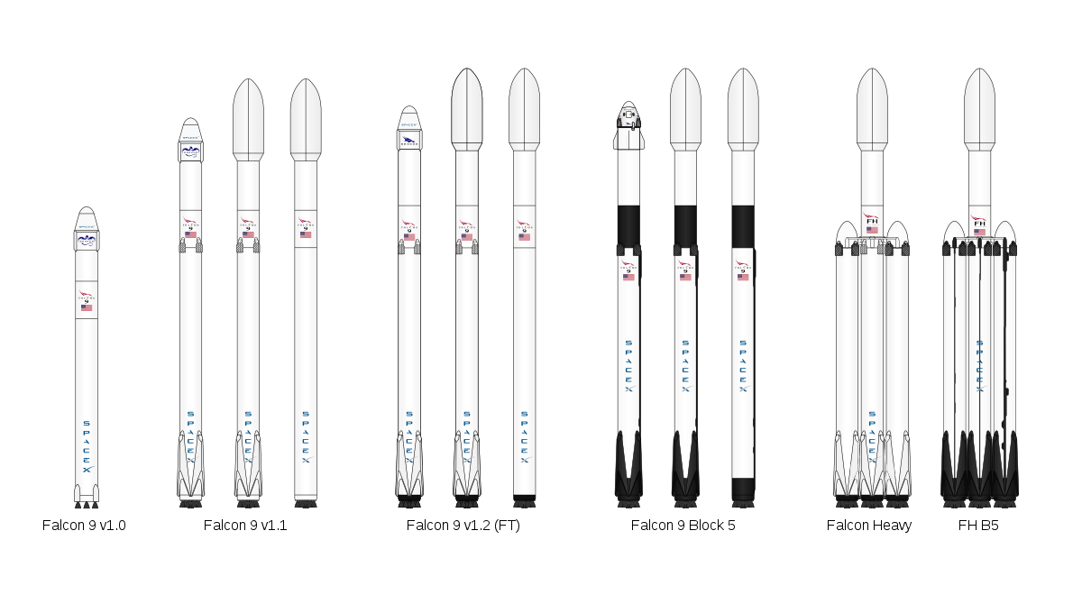
Results
Exploratory data analysis results
Interactive analytics demo in screenshots
Predictive analysis results

Slide 17

Section 2
Insights drawn from EDA

Slide 18
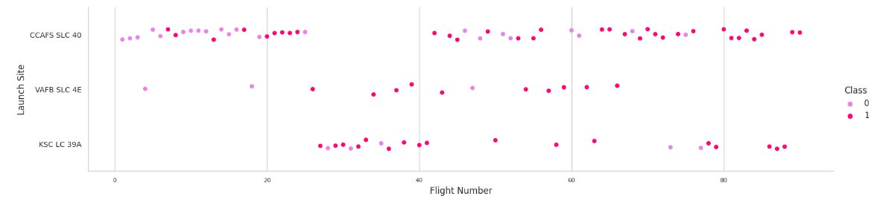
Flight Number vs. Launch Site
EDA with Visualization
The most recent successes have all occurred at CCAF5 SLC 40, making it the optimal launch point over the time.
The second successful launch location is VAFB SLC 4E, followed by KSC LC 39A.
Moreover, it is feasible to see a rise in success rate over time.

Slide 19
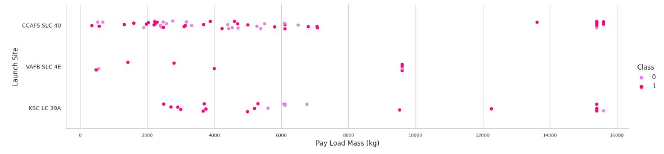
Payload vs. Launch Site
EDA with Visualization
The success rate for payloads exceeding 9,000kg is outstanding; payloads over 12,000kg are possible only at the CCAFS SLC 40 and KSC LC 39A launch sites.
This scatter plot demonstrates that after the payload mass exceeds 7,000 kg, the success rate probability will climb dramatically. Yet, there is no conclusive evidence that the launch site's success percentage is dependent on the payload's mass.

Slide 20

Success Rate vs. Orbit Type
EDA with Visualization
SSO, HEO, GEO, and ES-L1 orbits all resulted in a success rate of one hundred percent, whereas SO orbit resulted in a failure rate of one hundred percent.
The bar chart depicted the potential for orbits to influence landing results. However, a deeper examination finds that certain orbits, such as GEO, SO, HEO, and ES-L1, have only one occurrence, indicating that this data need additional datasets to identify patterns or trends before we can draw conclusions.

Slide 21
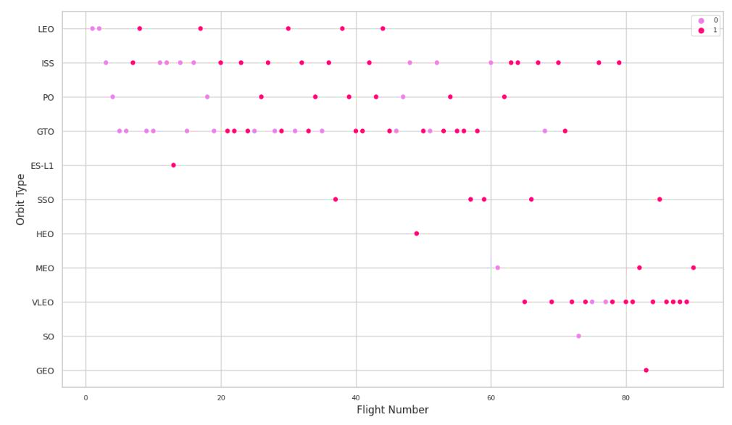
Flight Number vs. Orbit Type
EDA with Visualization
The scatter plot reveals that, with the exception of the GTO orbit, the more the flight number on each orbit, the higher the success rate (particularly on the LEO orbit).
Orbits with a single occurrence should likewise be excluded from the preceding statement, as it requires further information.
Apparently, success rates for all orbits have increased over time; the VLEO orbit represents a new economic possibility because its frequency has just increased.

Slide 22
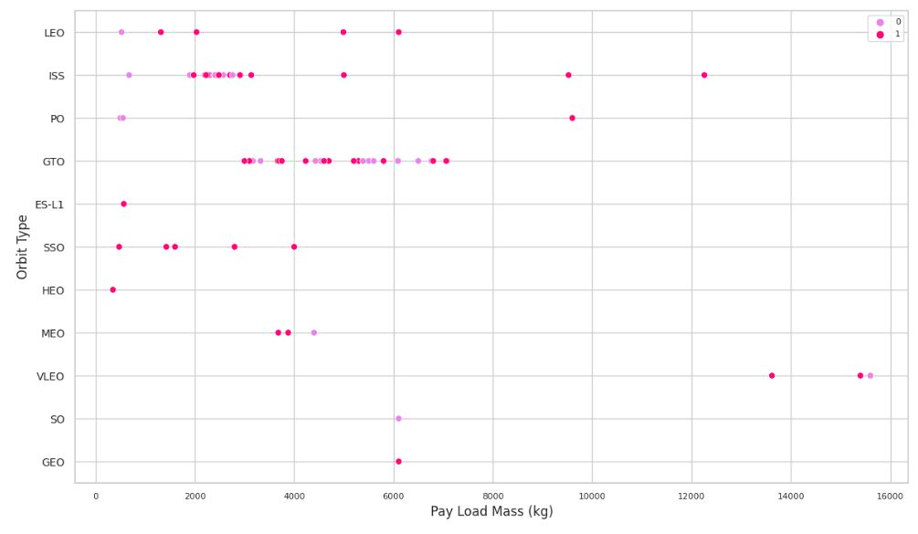
Payload vs. Orbit Type
EDA with Visualization
LEO, ISS, and P0 orbits all benefit from bigger payloads. The impact is negative for MEO and VLEO orbits. There appears to be no correlation between the GTO orbit's depicted properties. Moreover, additional information is necessary for SO, GEO, and HEO orbits to discover trends or patterns.
It is essential to remember that heavier payloads may have a negative impact on GTO orbits but a positive impact on ISS and LEO orbits.

Slide 23
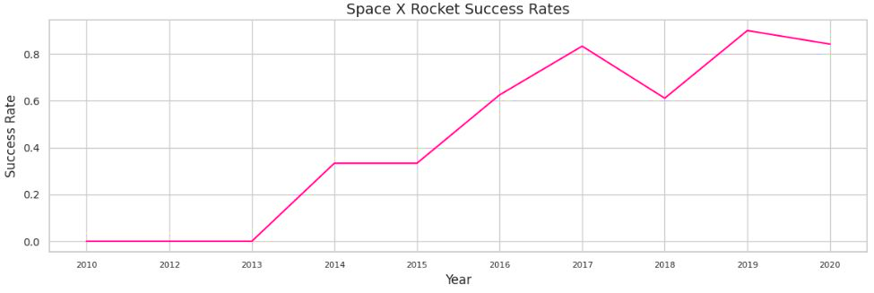
Launch Success Yearly Trend
EDA with Visualization
From 2013 through 2020, the line chart clearly illustrates a growing tendency. If this pattern continues over the following year and beyond, the success rate will eventually rise to 100%.
The success rate began to rise in 2013 and continued to rise until 2020. It appears that the first three years were a time of technological adjustment and development.

Slide 24
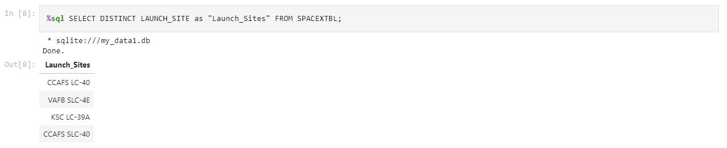
All Launch Site Names
EDA with SQL
We ran a SQL query on the SPACEXTBL dataset with the keyword DISTINCT to retrieve the unique names of the launch sites.
Based on the query results, there are four launch locations. They are derived by filtering the dataset for unique instances of "launch_ values."

Slide 25
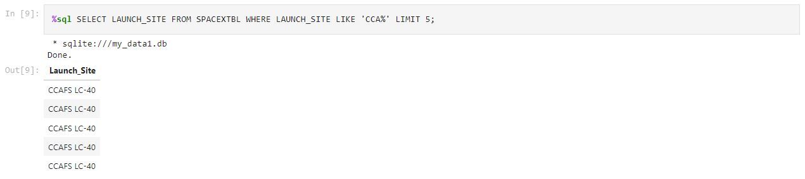
Launch Site Names Begin with ‘CCA’
EDA with SQL
The following query was performed to retrieve the results for the top 5 launch sites that start with the characters 'CCA’.
The LIMIT 5 clause specifies that just the first five records from SPACEXTBL will be returned, and the LIKE keyword serves as a wild card by matching any string, so the string "CCA%" implies that the "LAUNCH_SITE" name must begin with CCA.

Slide 26
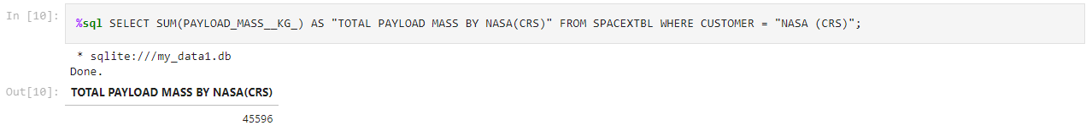
Total Payload Mass
EDA with SQL
With the query below, we were able to estimate that NASA boosters have carried a total of 45596 kilos of payload.
The SUM function is used to aggregate the values in the column labeled PAYLOAD MASS KG . With the WHERE clause, we can restrict our data collection and obtain exact results for the Customer column with a NASA (CRS) value.

Slide 27
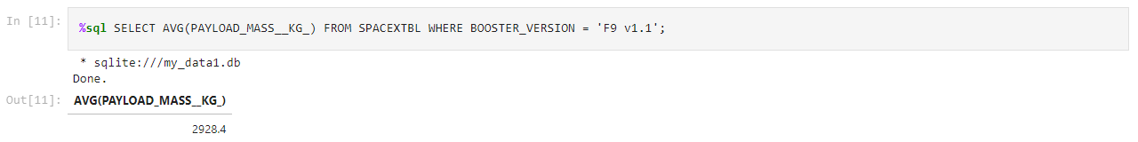
Average Payload Mass by F9 v1.1
EDA with SQL
With the query below, we determined that version F9 v1.1 of the booster had an average payload mass of 2,928.4 kilograms.
The average value in the field PAYLOAD MASS KG is calculated by the function AVG. With the WHERE clause, we can restrict the data set to just include rows about Booster version F9 v1.1 for analysis.

Slide 28
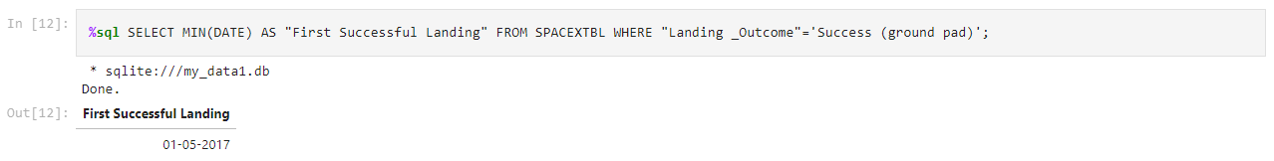
First Successfull Ground Landing Date
EDA with SQL
The date of the ground pad landing's successful outcome was obtained using the query below. To verify this, we made use of the MIN() function. On May 1, 2017, we observed the first successful landing outcome on a ground pad.
The minimum date in the column Date was calculated using the MIN() method. To narrow down the data set, we use the WHERE clause to look for the value "Success (ground pad)" in Landing _Outcome Success.

Slide 29
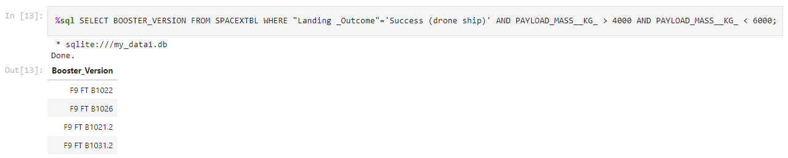
EDA with SQL
Successful Drone Ship Landing
with Payload between 4000 and 6000
With the use of the query below, we were able to pull out Boosters that have successfully landed on drone ship and had a payload mass of more than 4000 but less than 6000.
We selected the column labeled BOOSTER_VERSION from the table. To narrow down the data collection, we utilize the WHERE clause to specify that Landing_Outcome must be "Success" (drone ship). Further filter conditions are listed in the AND clause. Both the Payload MASS KG 4000 and 6000 parameters are required.

Slide 30
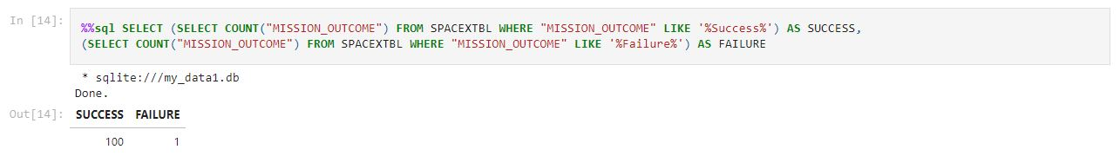
EDA with SQL
Total Number
of Successful and Failure Mission Outcomes
We utilized the WHERE clause in nested queries to narrow the data, the LIKE '%' statement to filter "Success" and "Failure" statements in the MISSION OUTCOME column, and subqueries to aggregate the results. The following summary was derived from the query by counting records for each subquery.

Slide 31
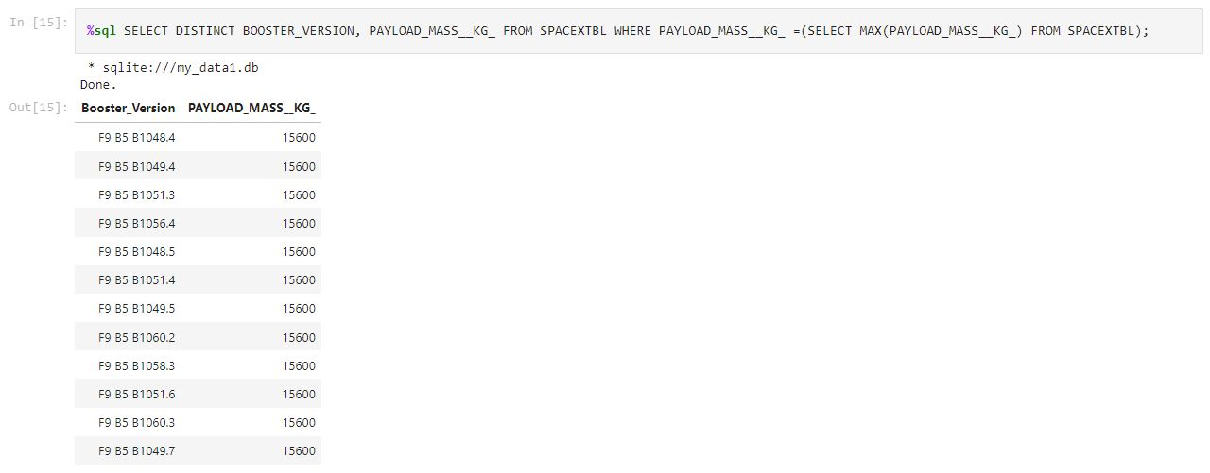
Boosters Carried Maximum Payload
EDA with SQL
By utilizing a WHERE clause and the MAX() function in a subquery, we were able to identify the booster that contained the most mass. Before collecting the maximum payloads from the table using the WHERE clause, we used the DISTINCT clause in the main query to retrieve only the unique booster versions from the BOOSTER VERSION column.

Slide 32
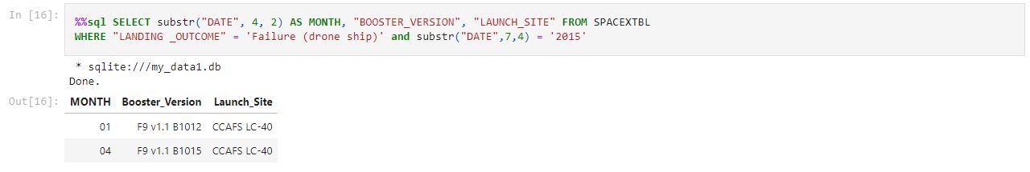
2015 Launch Records
EDA with SQL
We selected the BOOSTER_VERSION and LAUNCH_SITE columns and filtered the DATE column using substr(Date, 4, 2) to retrieve just months. Then, we utilized the WHERE clause to get "Failure (drone ship)" values from the LANDING OUTCOME column and the AND statement in the WHERE clause to choose the year 2015 by using substr(Date,7,4)='2015'.

Slide 33
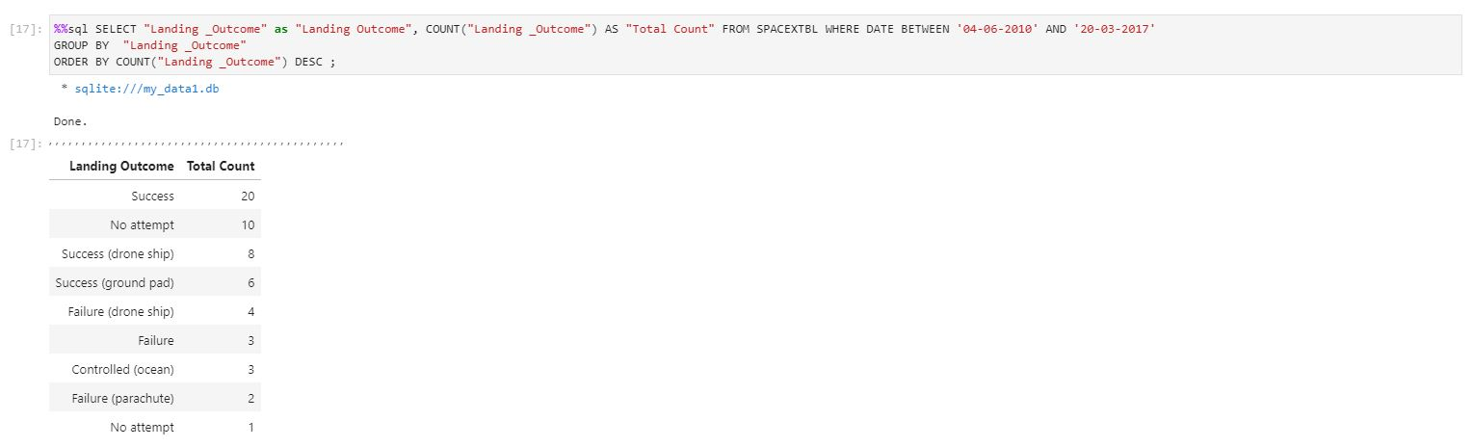
EDA with SQL
Ranking Landing Outcomes
Between 2010-06-04 and 2017-03-20
We selected Landing_Outcomes and the COUNT of landing outcomes from the data and used the WHERE clause to filter for landing outcomes BETWEEN 2010-06-04 and 2010-03-20. We applied the GROUP BY clause to group the landing outcomes and the ORDER BY clause to order the grouped landing outcomes in descending order.

Slide 34
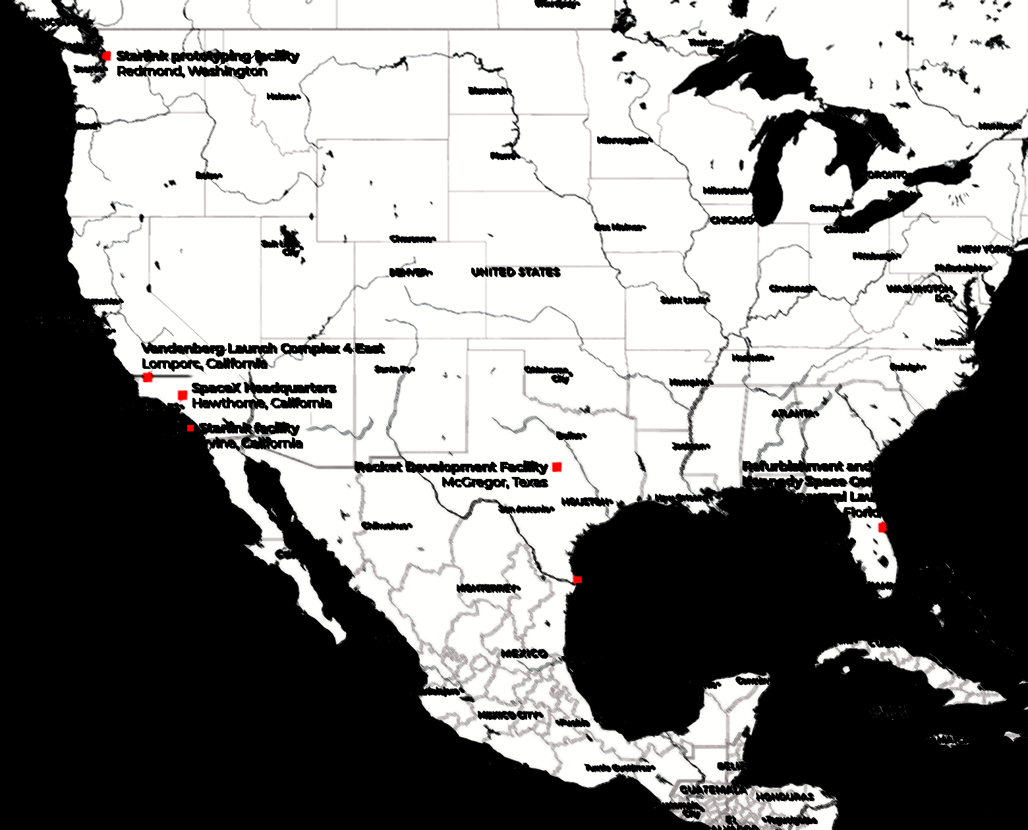
Section 3
Launch Sites Proximity Analysis

Slide 35
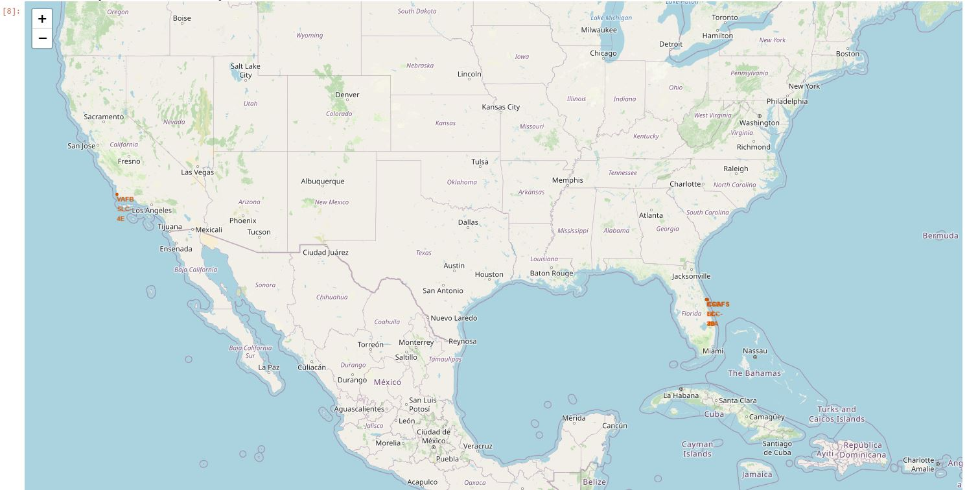
The Map with Marked Launch Sites
Folium
As seen on the map, each and every one of SpaceX's launch locations are located entirely within the United States.

Slide 36
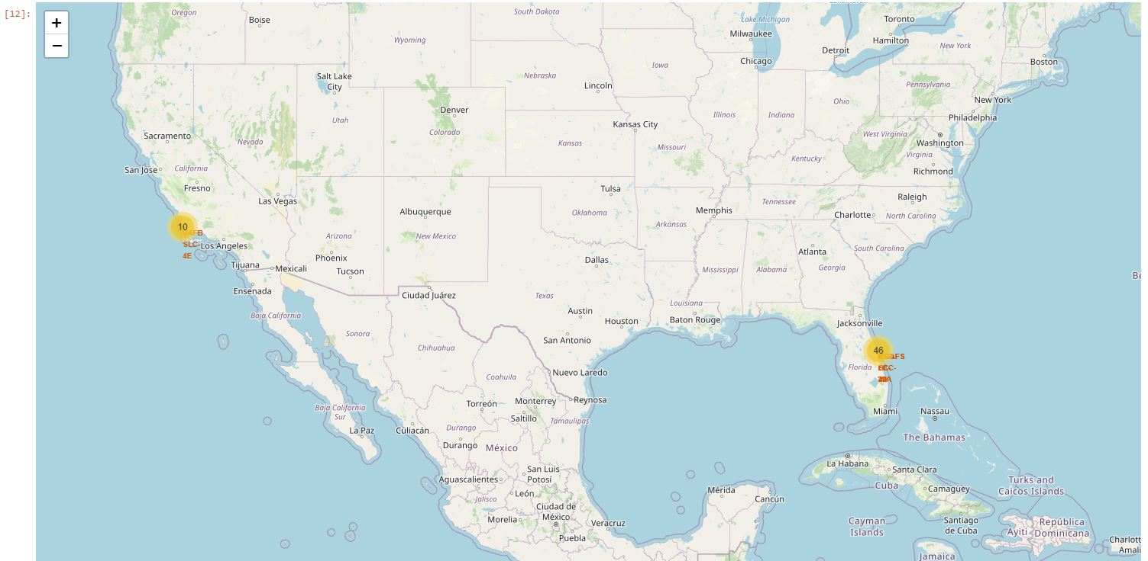
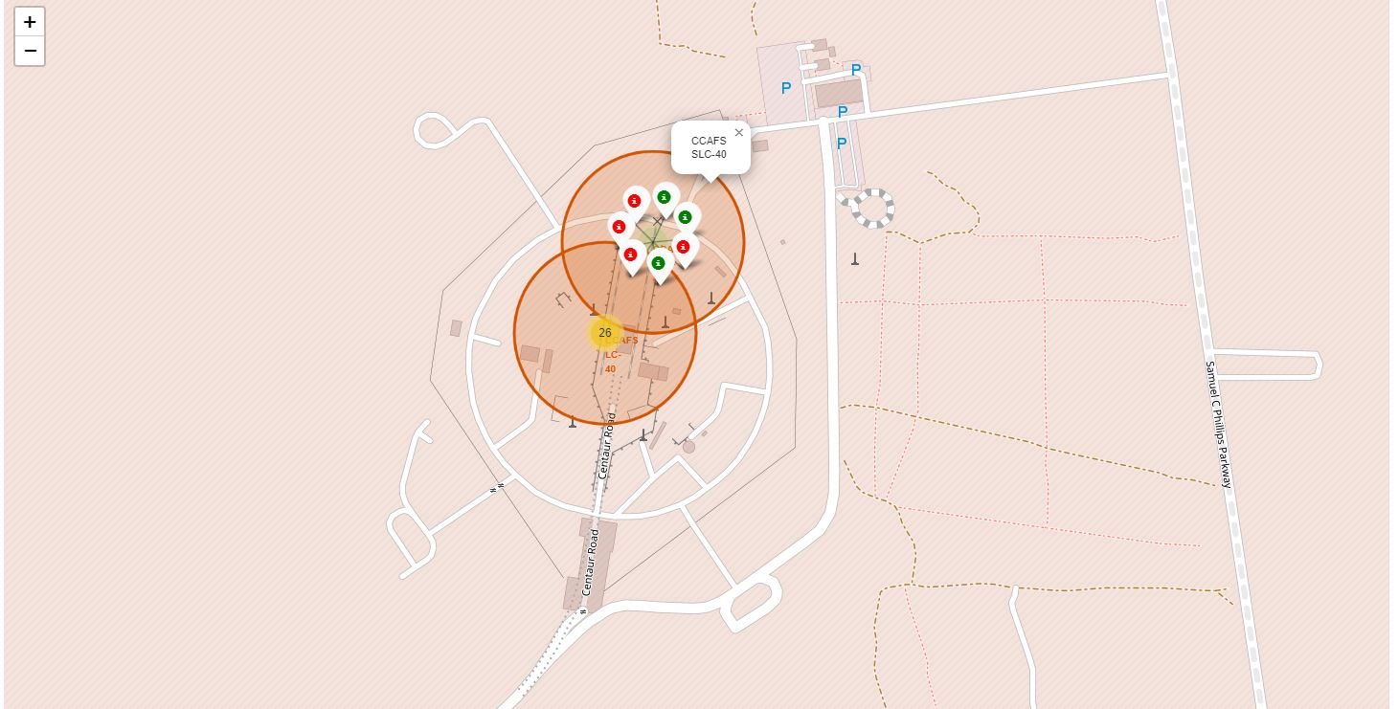
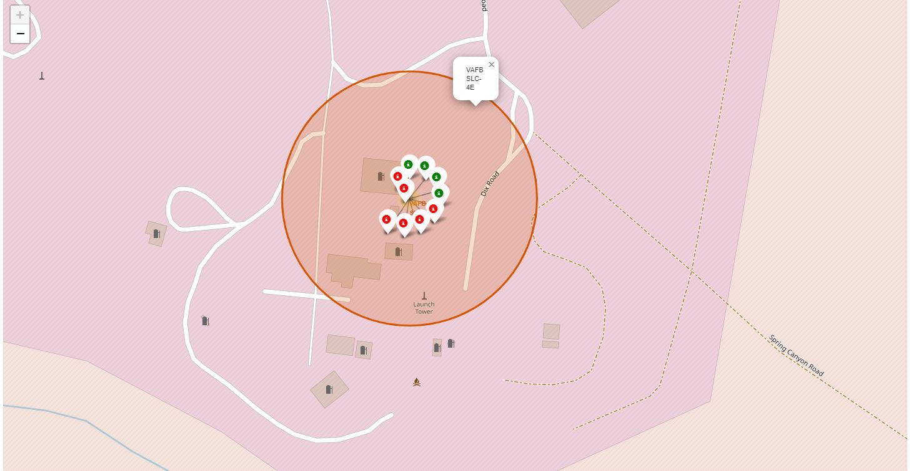
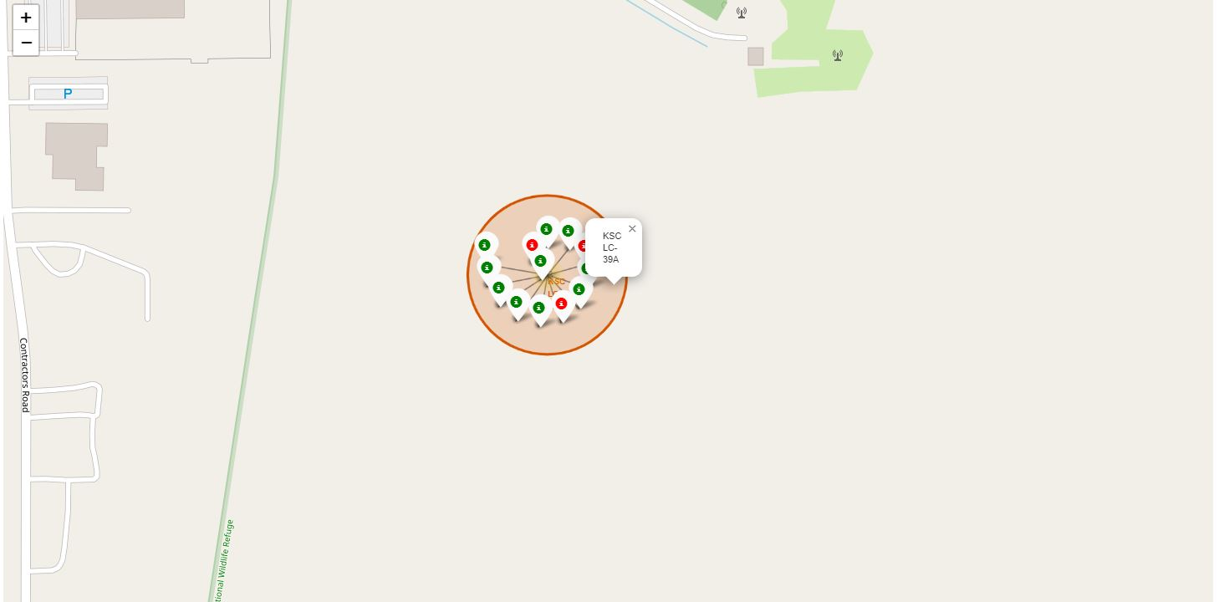
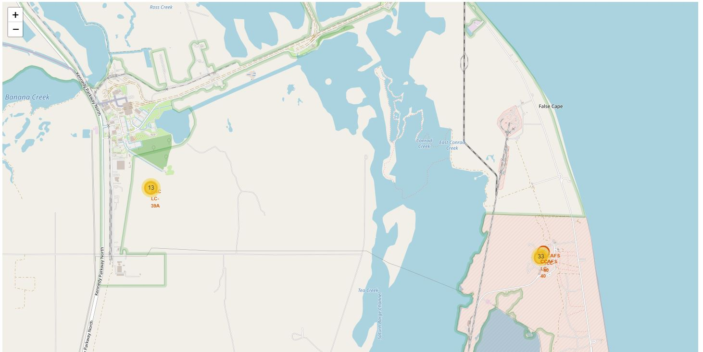
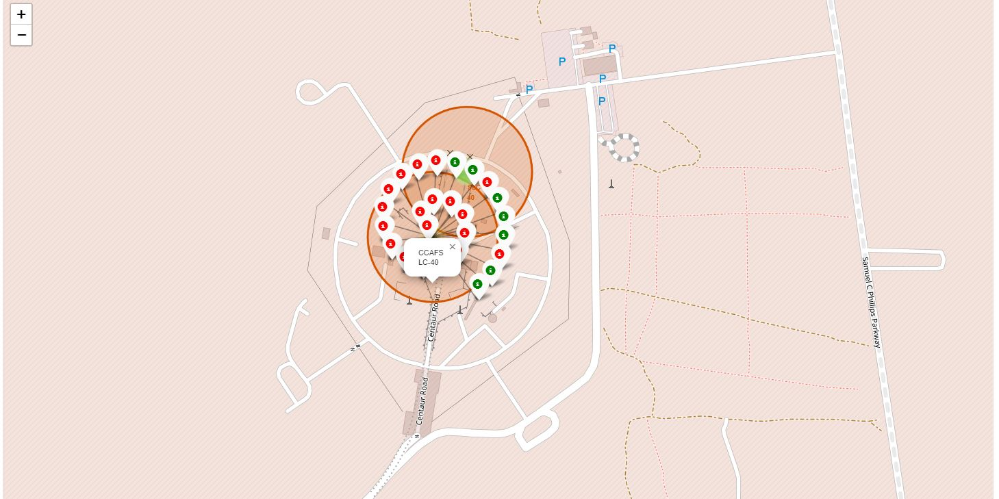
The Map with Marked Launch Sites
Folium
California Launch Sites
Green marker = successful
Red marker = failure.
Florida Launch Sites

Slide 37
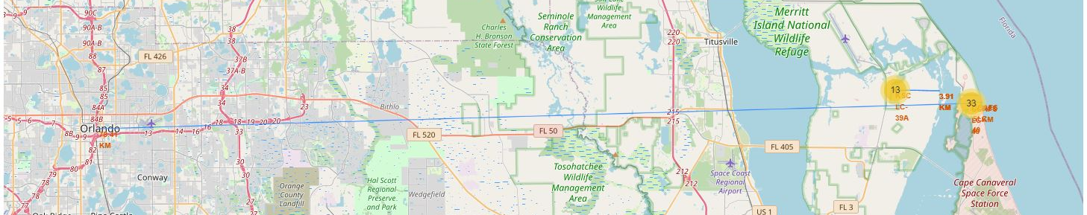
Relative Proximity of Launch Sites
Folium
We calculated the distance between launch sites and landmarks using the Haversine formula in order to identify trends in their locational characteristics. Distances between launch locations CCAFS LC-40 and the city center and KSC LC-39A and the coast are depicted in the image below.

Slide 38

Section 4
Build a Dashboard with Plotly Dash

Slide 39
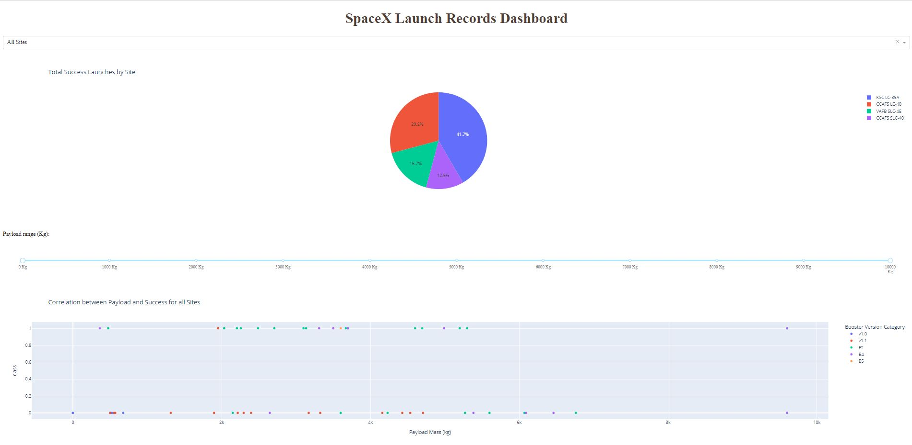
The Highest Success Rates by Site
Plotly | Dash
With a 41.7% success rate, KSC LC-39A had the highest rate of successful launches among all locations. CCAFS LC-40 is the second launch site, with a success rate of 29.2%.
With a 16.7% success rate, VAFB SLC-4E appears to be the third-highest rate location. CCAFS SLC-40 is the fourth launch location and has a 12.5% success rate.

Slide 40
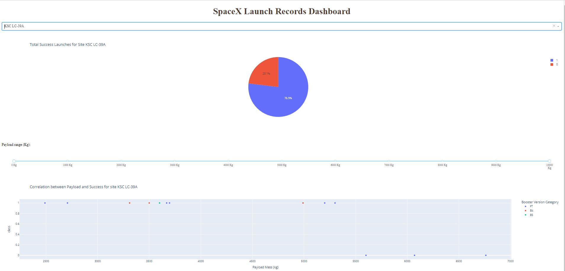
Plotly | Dash
The highest launch-success ratio:
KSC LC-39A
The success rate for KSC LC-39A was 76.9%, while the failure rate was 23.1%.

Slide 41
Plotly | Dash
Scatter Plot
Launch Outcome vs. Payload
The majority of launches with payloads under 2,000 kg were unsuccessful.
The majority of launches between 2,000 and 4,000 kg were successful.
The most successful launches had weights between 2,000 and 4,000 kg.
The failure rate for launches with payloads between 4,000 and 6,000 kg was greater than the success rate.
Except for one, all launches with payloads higher than 6,000 kg were unsuccessful.

Slide 42

Section 5
Predictive Analysis
(Classification)

Slide 43
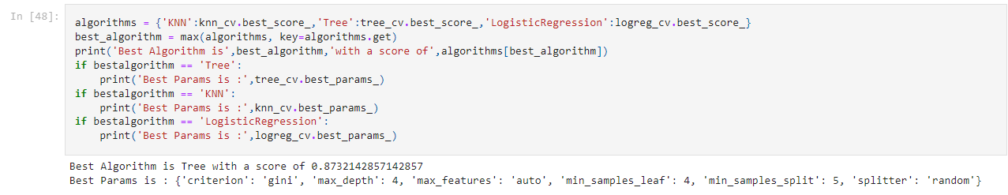
Classification Accuracy
As shown by the bar chart, the accuracy of all classification algorithms for the test dataset is same; however, the classification tree algorithm has the highest accuracy for the training dataset. To test this outcome, the above code demonstrates that the classification tree algorithm is the most accurate model.

Slide 44
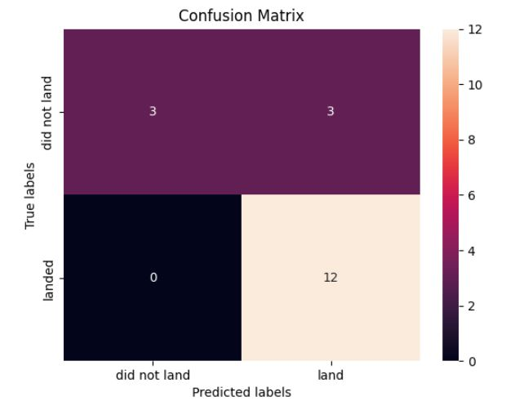

Confusion Matrix
The confusion matrix for the decision tree classifier demonstrates that the classifier can differentiate between classes. The primary issue is false positives. The classifier considers an unsuccessful landing as a successful landing.

Slide 45
Conclusions
For this dataset, our analysis leads us to the following conclusion:
The Tree Classifier Algorithm is the most effective machine learning technique.
The performance of lighter payloads (those weighing 4,000 kg or less) was superior to that of heavier payloads.
Launching more than 6,000 kilos carries a considerable risk of failure.
Starting in 2013, the success rate for SpaceX launches increased, directly proportional to the number of years until 2020, when it will eventually perfect the launches in the future.
Among launch sites at KSC, LC-39A has the highest success rate (76.9%).
SSO orbits have the highest success rate (100% or more than 1 occurrence). GEO, HEO, SSO, and ES L1 are the most often used orbital trajectories.

Slide 46
THANK YOU!

